Slide 1
Tokenizers
UNDERSTAND & CREATE LLM FROM THE GROUND UP

Slide 2
Agenda
Tokenization fundamentals – vocab design, compute cost
Self-attention inside the Transformer – Q · Kᵀ/√d, multi-head
Full vs PEFT fine-tuning – LoRA, Prefix, Q-LoRA trade-offs
Alignment pipelines – RLHF & DPO – how we keep models helpful
Recap + Q&A / Hands-on next steps

Slide 3
What We’ll Achieve Together
Build intuition for tokenizers – see how raw text becomes model-ready tokens in milliseconds.
Hands-on walkthrough – run a live demo that tokenizes and embeds a short paragraph.
Link theory to practice – map each step to the Transformer blocks we meet next.
Take-away cheat-sheet – leave with a one-page reference you can reuse in any LLM project.

Slide 4
How We’ll Get There
Build intuition for tokenizers – see how raw text becomes model-ready tokens in milliseconds.
Hands-on walkthrough – run a live demo that tokenizes and embeds a short paragraph.
Link theory to practice – map each step to the Transformer blocks we meet next.
Take-away cheat-sheet – leave with a one-page reference you can reuse in any LLM project.

Slide 5
Key Concepts We’ll Build On
Concept | Why it matters
Point → Vector → High-Dimensional Vector | These are the numerical building blocks that allow text to be represented inside a model.
Large Language Models (LLMs) | AI systems that read, write, and reason in natural language—powering chat interfaces and text-generation tools.
What an LLM actually does | Takes your prompt, turns it into vectors, predicts the next tokens, and streams the result back as readable text.
Well-known LLM families | GPT (ChatGPT), Claude, Gemini, DeepSeek, Qwen, Grok, Llama.

Slide 6
How an LLM Generates Text
Tokenize the prompt – break the input string into tokens and turn them into numerical IDs.
Embed & analyze context – feed those IDs through Transformer layers that capture meaning and relationships.
Score the vocabulary – compute a probability for every token in the vocab (SoftMax distribution).
Pick the next token – choose the highest-probability token (greedy) or sample from the top-k / nucleus set.
Loop – append the chosen token to the prompt and repeat until a stop condition is met.

Slide 7
Worked Example: Next-Word Prediction
Prompt (input)
| “The sun is shining, and the sky is ☐”
Model output (top candidates)
Candidate | Probability
blue | 0.60
clear | 0.18
cloudy | 0.11
bright | 0.04
… | …

Slide 8
Strategies (How the Model Picks the Next Token)
Strategy | Core idea | Example output* | When you’d use it
Greedy | Always take the single highest-probability token. | Prompt: “The sun is shining and the sky is …” → blue | Factual answers, code, step-by-step instructions.
Random (pure) | Sample from the full probability distribution. | Same prompt → cloudy (could be any word, even unlikely) | Brainstorming demos, AI games, creativity showcases.
Top-k sampling | Restrict to the k most-likely tokens, then sample. | With k = 3: {blue, clear, cloudy} → clear | Chat, story-telling, marketing copy.
Temperature | Scale logits before soft-max (T↑ = flatter distribution). | T = 1.0 may yield azure; T = 0.2 stays at blue | Fine-tuning creativity without changing k.
*All examples use the prompt fragment “… and the sky is ☐” to keep them comparable.
Rule of thumb:
| Lower randomness (Greedy, low T) → predictable & precise.
| Higher randomness (Random, large k, high T) → creative & surprising.

Slide 9
Anything Can Be a Token
Anything can be embedded as a token that AI can generate (predict based on preceding text):
Word – car
Letter – b
Number – 123
Emoji – 🌲
Chinese character – 车
Sentence – The sun rises in the east.
Chinese sentence – 你好 (nǐ hǎo)
Arbitrary string – A1B2$3]!FDC3!@#

Slide 10
Token Example and What Model Learns
Word-token example: car
  Recognised as a vehicle
  Associated with four wheels
  People drive it
  Used for transportation
Character-token example: b
  Second letter of the English alphabet
  Starts words like book, bird
  Appears in spelling, acronyms, and codes

Slide 11
Cont..
Number-token example: 123
  Represents a specific quantity
  Fits counting sequences (1-10) & maths rules
  Seen in dates, IDs, measurements
Emoji-token example: 🌲
  Categorised as an emoji
  Symbolises tree / forest / nature
  Adds tone or context in informal text

Slide 12
Cont..
Sentence token: “The sun rises in the east.”
  States a daily natural fact
  Subject + verb + prepositional phrase
  Can be used literally or metaphorically
Chinese-sentence token: “我们在学人工智能” (“We are studying AI.”)
  Chinese syntax & tense
  Describes an ongoing action
  Returned when context asks what someone is doing

Slide 13
Cont..
Sentence token: “The sun rises in the east.”
  States a daily natural fact
  Subject + verb + prepositional phrase
  Can be used literally or metaphorically
Chinese-sentence token: “我们在学人工智能” (“We are studying AI.”)
  Chinese syntax & tense
  Describes an ongoing action
  Returned when context asks what someone is doing
Arbitrary-string token: A1B2$3]!FDC3!@#
  Mixed letters, numbers, symbols
  Rare in normal prose; may be a code or password
  Low semantic meaning → shows tokenizers must still map everything

Slide 14
Choosing Token Granularity
The question here is, which way of tokenizing is best:
Prompt: “The cat is sleeping”
Take-away: Modern LLMs use sub-word tokenizers (BPE/WordPiece) that strike a sweet spot between sequence length and semantic fidelity.
Variant | Token sequence
Sentence | The cat is sleeping
Word | The, cat, is, sleeping
Character | T, h, e, , c, a, t, …

Slide 15
Token Compute Cost
Key principle: every token—costs the same amount of compute.
Take-away: shorter sequences → less GPU time. That’s why token design matters.
Tokenizer | Tokens produced | Relative compute
Sentence | 1 | 1 ×
Word | 9 | 9 ×
Letter | 44 | 44 ×

Slide 16
Word-Level Tokenizers Don’t Scale
Massive vocabularies – every form of every word (run, runs, running) inflates the compute-heavy probability table.
Missing word = OOV – if ‘running’ isn’t in the vocab, the model simply can’t learn it.
Typos become <UNK> – spell avocdo and the model replaces it with an “unknown” token.
Sparse statistics – most words appear too rarely to learn strong embeddings.
No compositionality – unlike letter/sub-word tokenizers, it can’t invent new words on the fly.
| Sentence-level tokens amplify every one of these problems by orders of magnitude.

Slide 17
Sentence-Level Tokens & What Comes Next
Problems scale up – all word-level drawbacks (huge vocab, OOV, sparse stats) are magnified when an entire sentence is a single token.
Today’s reality – compute and memory make sentence tokens impractical for large-scale LLMs.
Fast-moving research – breakthroughs could eventually change that; keep an eye on compressive attention & neural codec approaches.
Design challenge – can we enjoy the low vocab of letter tokens and the efficiency of word tokens?
  Hint: sub-word schemes (BPE, WordPiece, SentencePiece) are the current “best-of-both-worlds” answer.

Slide 18
Sub-word Tokens: The BPE Sweet Spot
Instead of storing every verb form…
[run, running, play, playing, stay, staying]
…a sub-word tokenizer splits and re-uses chunks:
[run, play, stay, ing]
Why that matters:
Compositional power – model learns “base verb + ing ⇒ present-continuous” and can build running, playing, staying, etc.
Compute-friendly – far fewer tokens than letter-based splitting.
Slimmer vocab – tens of millions → a few hundred K.
Resilient to typos – runnnng still partly matches known chunks.

Slide 19
A Real Tokenizer: Qwen 2.5
🔗 https://huggingface.co/Qwen/Qwen2.5-7B/raw/main/tokenizer.json
Take-aways
Sub-word vocab of ≈151 K keeps memory & compute tractable.
Those integer IDs feed the embedding layer—the next step in “how LLMs store meaning.”
What you’ll see | Why it matters
"sh" → 927 | Each sub-word chunk maps to an integer ID.
"ual" → 928 | IDs run 0 – 151663 (≈151 K tokens total).
"new" → 931 | Model’s lookup table = vocab size × embedding dim.

Slide 20
To understand what we need numbers for, we need to go back and understand how exactly LLMs "understand and store semantic meaning" of a token.
“Transformers can only do math; embeddings let them reason about meaning with math.”
raw text → token IDs → embedding vectors → Transformer
Transformers are calculators, not readers.
To reason about language, they need:
  Raw text → tokens (IDs)
  Tokens → vectors (embeddings)
  Vectors → context-aware predictions
Why Convert Text to Numbers?

Slide 21
What Is a Vector Embedding?
A fixed-length array of real numbers that places a token at a point in a high-dimensional semantic space.
Vector embedding is just an array of numbers
Example (8-D slice of a 768-D vector)
[ 0.43, 0.76, 0.13, –0.55, 0.07, –0.12, 0.44, 0.22, … ]
Quick facts
Dimension d: 256 – 4096 in modern LLMs
Learned, not handcrafted
Geometry encodes meaning: closer = more similar

Slide 22
Every Token Gets Its Own Vector
Token (string) | Token ID | First 6 numbers in its vector
car | 1 231 | 0.84 · 0.01 · 0.31 · 0.03 · …
grass | 9 870 | 0.01 · 0.97 · 0.89 · 0.82 · …
In reality these models use ~1 000 dimensions long vectors; each number captures some feature the model discovers during training.
E.g.: quickness, aliveness, greenness, fluffiness, playfulness, vehicleness, parallel universalness, activeness, and who knows what else [we don't] - each feature will be a measure of some characteristic, and it will contribute to the meaning.
AI learns by itself what each feature should be about, and the numerical value of it for each token, and we don't know what exactly those numbers represent.

Slide 23
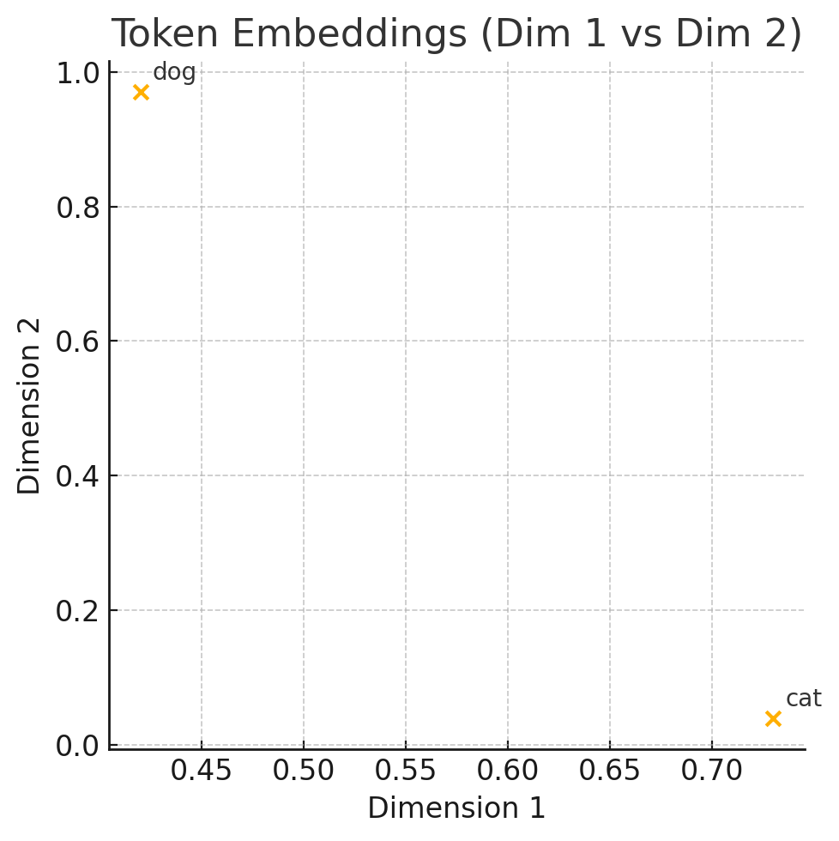
Similar Tokens Sit Close Together
Let's take these 2 tokens as an example.
Similarity is usually measured with cosine distance.
dog | [0.42, 0.97, 0.95, 0.18]
cat | [0.73, 0.04, 0.01, 0.12]

Slide 24
Feature 1: Fluffiness Amount
| How soft, fuzzy, and likely to leave hair on your favorite hoodie?
Dog → 0.42
Dogs come in all fluff levels, from bald weirdos to walking cotton balls.
Cat → 0.73
Living fur clouds. Built for maximum softness.

Slide 25
Feature 2: Willingness to Save Your Life
| If you're in a lake and can't swim… will it save you?
Dog → 0.97
Leaps in with heroic urgency. Risks life. Brings floaty.
Cat → 0.04
The one who pushed you into the water.

Slide 26
Feature 3: Gratefulness
| How much it appreciates everything you do for it?
Dog → 0.95
Thinks you hung the moon. Worships your every move. Applauds your shoe-tying skills.
Cat → 0.01
You are but a mere butler, void of any purpose beyond servitude.

Slide 27
Interpreting Dimensions
Note that names of these features are illustrative; real models don’t have human-readable axes.
Important Caveat
One dimension may encode different traits for different tokens.
Several dimensions can combine to express a single concept.
Dimension | Dog | Cat
Fluffiness | 0.42 | 0.73
Heroism | 0.97 | 0.04
Gratefulness | 0.95 | 0.01

Slide 28
How the Model Learns Embeddings
Learned, not hand-engineered.
These vector embeddings aren't manually created by human scientists — the AI learns them by reading the entire data (trillions of words), trying to predict the next token as it had read it, and adjusting vector embeddings for each token and other numbers (parameters) so its predicted token matches the actual token in the training data.
Back-propagation clusters similar contexts
When the model guesses the next token incorrectly, it tweaks each token’s vector and other parameters, so the correct token is more likely—and the wrong ones less likely—the next time around.

Slide 29
How LLMs Use Vector Embeddings
“The car is fast, and the car is red.”
Tokens usually begin with a leading space (▁) to avoid encoding space as a separate symbol.
Token | → Vector (dim 4 sample)
“The” | [0.12, 0.34, 0.56, 0.78]
“▁car” | [0.84, 0.01, 0.31, 0.03]
“▁is” | [0.23, 0.45, 0.67, 0.89]
“▁fast” | [0.91, 0.12, 0.34, 0.56]
“,” | [0.55, 0.66, 0.77, 0.88]
“▁and” | [0.78, 0.90, 0.12, 0.34]
“▁red.” | [0.56, 0.78, 0.90, 0.12]

Slide 30
Sentence ➜ Embedding Matrix
LLMs replace each token with its vector:
[0.12, 0.34, 0.56, 0.78] … [0.56, 0.78, 0.90, 0.12]
That matrix feeds the first Transformer layer.
E.g.:
"The car is fast, and the car is red."
[0.12, 0.34, 0.56, 0.78] [0.84, 0.01, 0.31, 0.03] [0.23, 0.45, 0.67, 0.89] [0.91, 0.12, 0.34,
0.56] [0.78, 0.90, 0.12, 0.34] [0.84, 0.01, 0.31, 0.03] [0.23, 0.45, 0.67, 0.89] [0.56, 0.78,
0.90, 0.12] [0.55, 0.66, 0.77, 0.88] [0.78, 0.90, 0.12, 0.34] [0.56, 0.78, 0.90, 0.12]

Slide 31
Shared Vocabulary, Swappable Embeddings
But we don't want to tie tokens to vectors, because we want to use same token vocabulary for different versions of the model or models, which will have different vector embeddings for the same token.
Think of the tokenizer as a fixed dictionary (word → ID). When we train a new model, we only rewrite the definitions in that dictionary—the vectors—not the word list itself. Re-using the same IDs means every model version can read the same text data without re-tokenizing it, saving time and avoiding bugs.

Slide 32
Building the Embedding Matrix
We store vectors in an embedding table. Row i holds the vector for token index i.
  [
  [0.12, 0.34, 0.56, 0.78], # idx 0
  [0.84, 0.01, 0.31, 0.03], # idx 1
  ...
  ]

Slide 33
Index 0 Example
We assign the embedding vector of the token with index 0 to position 0 in the sequence.
During inference, we retrieve the corresponding embedding vectors by indexing into the embedding matrix using the input sequence of token indices.

Slide 34
Mapping Tokens to Indices
“The car is fast, and the car is red.” → 0 1 2 3 4 0 1 2 5
Token | Index
“The” | 0
“▁car” | 1
“▁is” | 2
“▁fast,” | 3
“▁and” | 4
“▁red.” | 5

Slide 35
Pulling Embeddings by Index
For each index (0 1 2 3 4 0 1 2 5) we fetch its row from the embedding table to build the token matrix.
[0.12, 0.34, 0.56, 0.78] [0.84, 0.01, 0.31, 0.03] [0.23, 0.45, 0.67, 0.89] [0.91, 0.12, 0.34,
0.56] [0.78, 0.90, 0.12, 0.34] [0.84, 0.01, 0.31, 0.03] [0.23, 0.45, 0.67, 0.89] [0.56, 0.78,
0.90, 0.12] [0.55, 0.66, 0.77, 0.88] [0.78, 0.90, 0.12, 0.34] [0.56, 0.78, 0.90, 0.12]

Slide 36
Why Separate Tokenizer & Embeddings?
It allows us to swap new embedding tables from updated models while reusing the same tokenizer—no need to rebuild datasets or inference code.

Slide 37
Thank You
(Q&A)

